Slide 1


Syriatel Customer Churn
Crisp DM Checkpoint #2
Vivian Dang and Joe Buzzelli
April 14, 2020

Slide 2
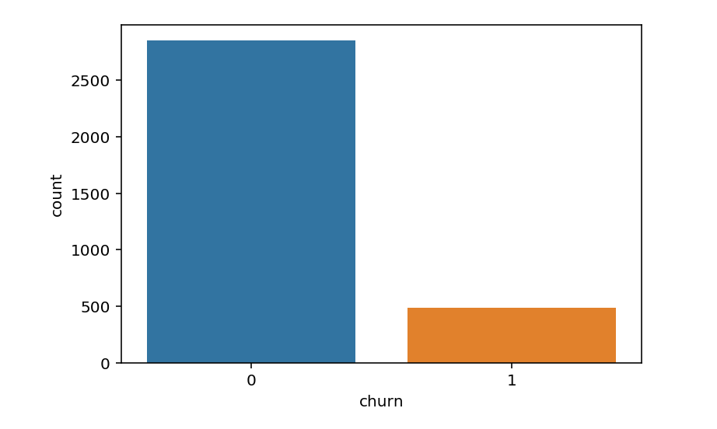
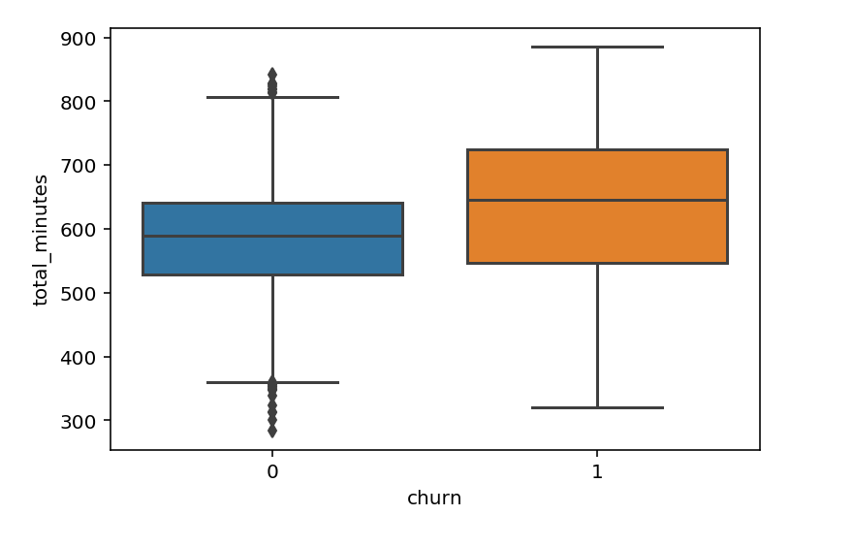
EDA/Visualization
As of 04/13, created EDA visualizations exploring the baseline data pertaining to customer churn
Baseline is roughly 14% churn
Total minutes most significant delta identified between classes

Slide 3
We are pursuing a classification modeling strategy
Our goal is to predict customer churn by creating a model that maximizes precision with a target greater than or equal to 0.95
Models used include:
Logistic regression
Decision tree
Random Forest
Nearest Neighbor
Boosting
In order to mitigate overfitting, we will conduct cross validation and hyperparameter tuning on our two best performing models
Additionally, we are exploring feature selection by leveraging the best feature calculations available in decision tree and random forest models

Slide 4
Initial Model Results (perfect scores equal -1.000)
Model | Precision | Accuracy | Recall | F1
Decision Tree (Tuned, max_depth = 5) | 0.979 | 0.858 | 0.997 | 0.92
KNN (k=4) | 0.978 | 0.904 | 0.343 | 0.51
Logistic Regression (default w/ SMOTE) | 0.952 | 0.925 | 0.896 | 0.92
KNN (default) | 0.942 | 0.913 | 0.429 | 0.59
Random Forest w/ SMOTE (max_depth=4, n_est=5) | 0.9273 | 0.928 | 0.879 | 0.92
KNN w/ SMOTE (default) | 0.728 | 0.669 | 1 | 0.84
Logistic Regression (default) | 0.704 | 0.883 | 0.331 | 0.45
Decision Tree ( max_depth = 5) w/ SMOTE | -1 | 0.916 | 0.832 | 0.91
Random Forest (default) | -1 | -1 | -1 | -1
Random Forest (max_depth=4, n_est=5) | -1 | 0.888 | 0.228 | 0.37
Decision Tree (default) | -1 | -1 | -1 | -1

Slide 5
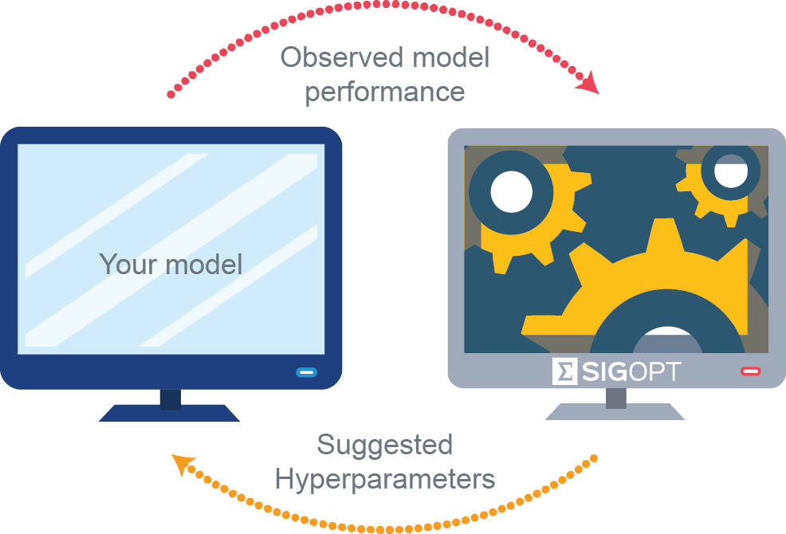
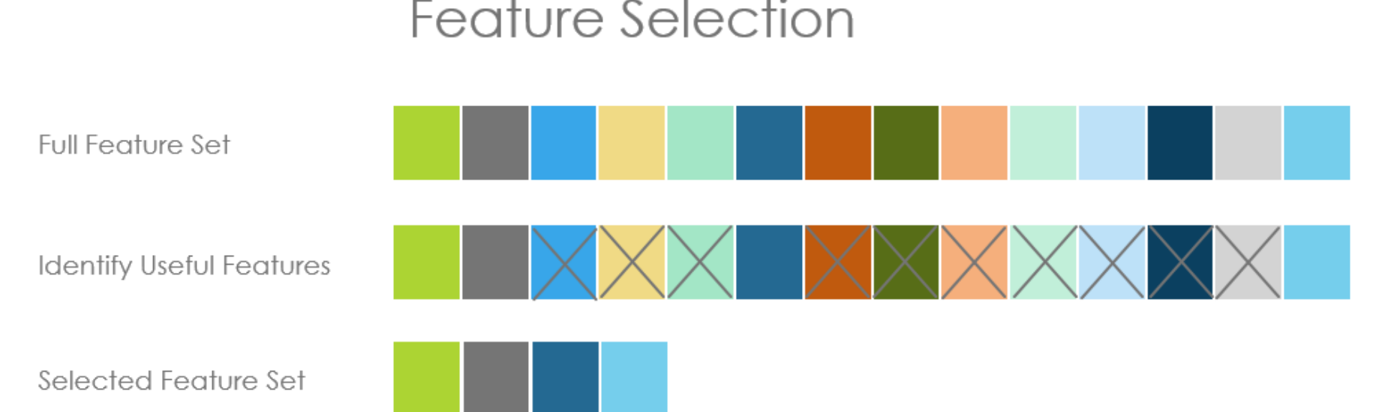
We are pursuing a classification modeling strategy
In order to mitigate overfitting, we will conduct cross validation and hyperparameter tuning on our two best performing models
Additionally, we are exploring feature selection by leveraging the best feature calculations available in decision tree and random forest models

Slide 6

Thank you for your time
Are there any questions?

